Slide 1

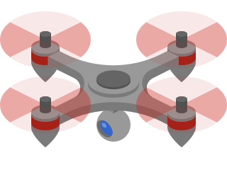







Plataforma de Drones Aéreos Multi-tecnologia para Suporte a Comunicações Críticas
Group 3
PECI 2021/2022

Slide 2
Index
1. Context
1.1 Problem
1.2 Objectives
1.3 Methodology
2. Solution
2.1 Communication
2.2 Data persistence
2.3 Dashboard
2.4 Outcome
3. Vision for the future

Slide 3
Context
UAV stands for Unmanned Aerial Vehicle (aerial drones).
UAVs can be small in size and cost-effective, making them an excellent alternative for some specific purposes.
Some examples of the real scenarios considered are: monitoring and support in emergency situations and natural disasters; patrol of urban areas and support to law enforcement; transfer of high-value lightweight objects.
In the scope of several previous UAV projects at the IT - Aveiro Telecommunications Institute, an ICT infrastructure has been developed over the years.
Notes:
- Introdução
- Atores

Slide 4
Problem
This project has the objective of exploring the full potential of UAVs in the context of supporting critical communications.
4

Slide 5
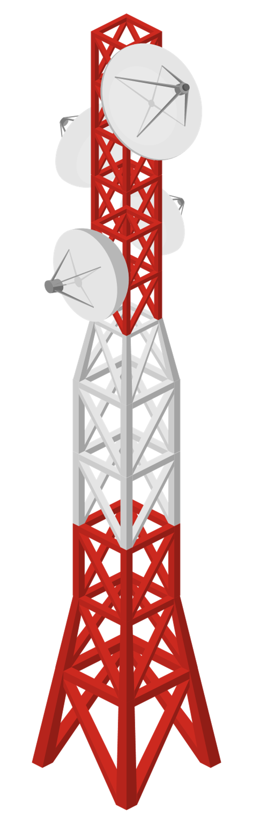



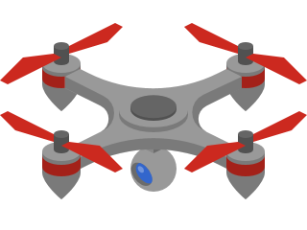

Scenario: LoRa backup

Slide 6
Scenario: Drone to groundstation communications
Desire to have less connection setup time and less Wi-Fi noise
Capacity to connect when moving
Having a mobile groundstation

Slide 7
Scenario: Common use
A common user programs a mission and loads it to the fleet manager
Visualize data
Check mission parameters

Slide 8
Problem
The Pc companion was limited.
Comunication was only done via WiFi.
The groundstation required a dedicated laptop.
Threre was no data persistance.
There was not a way to view/analyse data.
Creating a mission required technological know-how.

Slide 9
Objectives
Migrate the Pc companion to an APU v3.
Implement the groundstation in an APU v3.
Hardware

Slide 10
Objectives
Implementation of WAVE (802.11p) vehicular orientated protocol.
Implementation of LoRa (Long Range).
Comunication

Slide 11
Objectives
Enhanced dashboard.
Display metrics & statistics from API.
Develop user-friendly mission generator.
Dashboard

Slide 12
Objectives
Implementation of influx DB to store live telemetry.
Implementation of MySQL to store mission summary.
Upgrading an existent Django API.
Data Persistence

Slide 13
Methodology
We have divided the team into three distinct work sections in order to make the most efficient work.
Notes:
Dividimos a equipa em 3 secções diferentes, uma secção responsável pelas comunicações, outra responsável pela persistencia de dados e por fim uma responsável pela dashboard.
Como acreditamos desde inicio que a secção da comunicação seria a que daria mais trabalho destinamos 3 pessoas para esta. A secção da persistencia de dados foi composta por 2 duas pessoas e por fim a dashboard foi desenvolvida por um element do grupo.

Slide 14

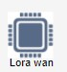


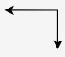
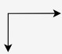



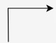
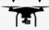

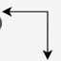
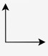
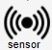





Architecture
Prototype
Past
Final
Drone Node
Web server application
Drone Gateway
Grounstation
14

Slide 15
Index
1. Context
1.1 Problem
1.2 Objectives
1.3 Methodology
2. Solution
2.1 Communication
2.2 Data Persistence
2.3 Dashboard
2.4 Outcome
3. Vision for the future
15

Slide 16
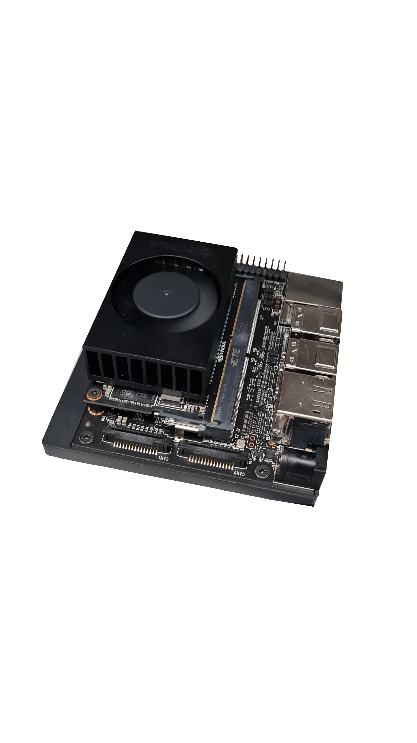
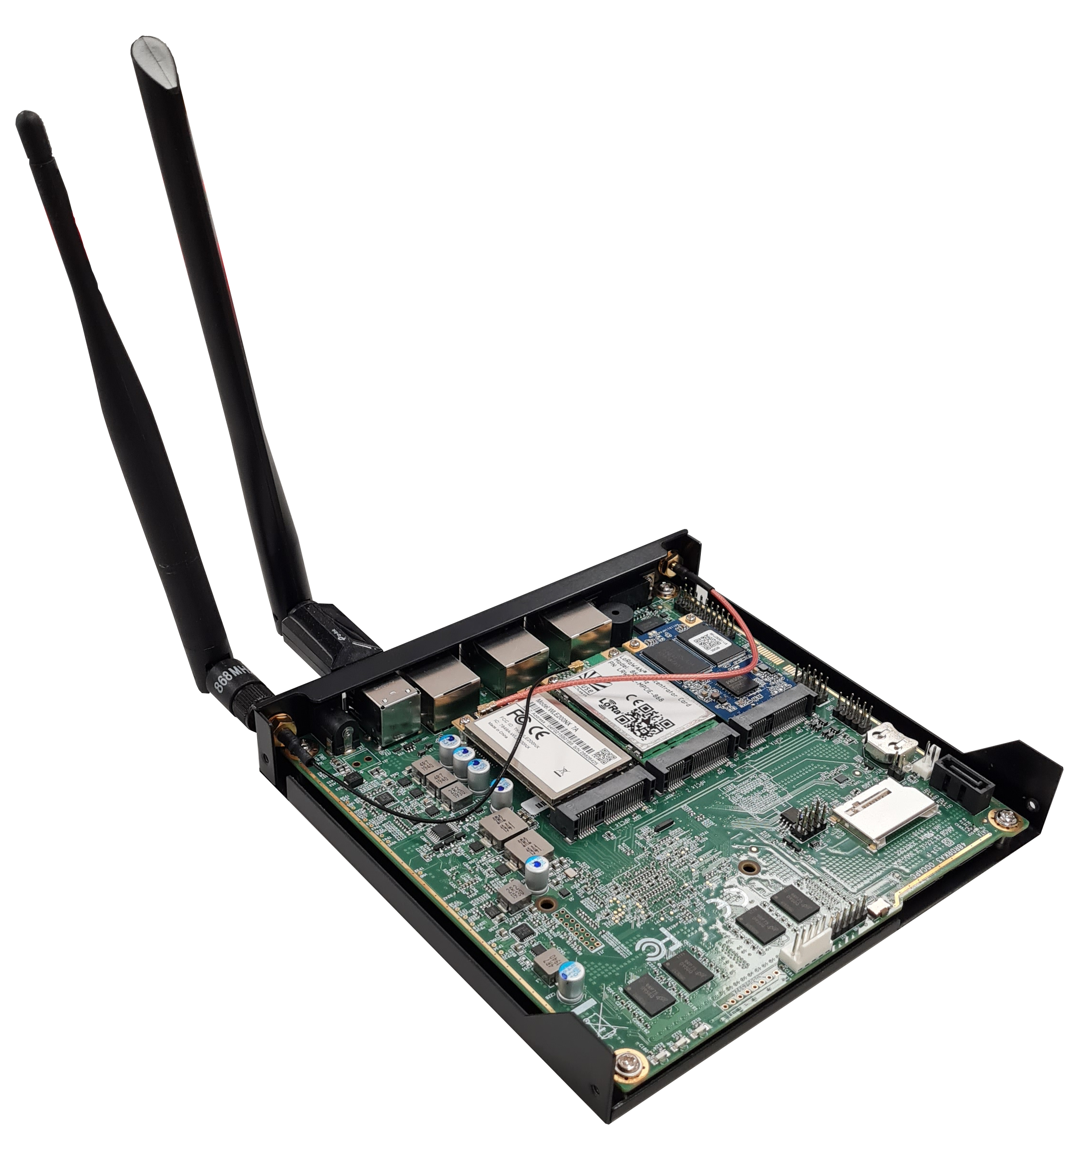
Solution Communication
16

Slide 17
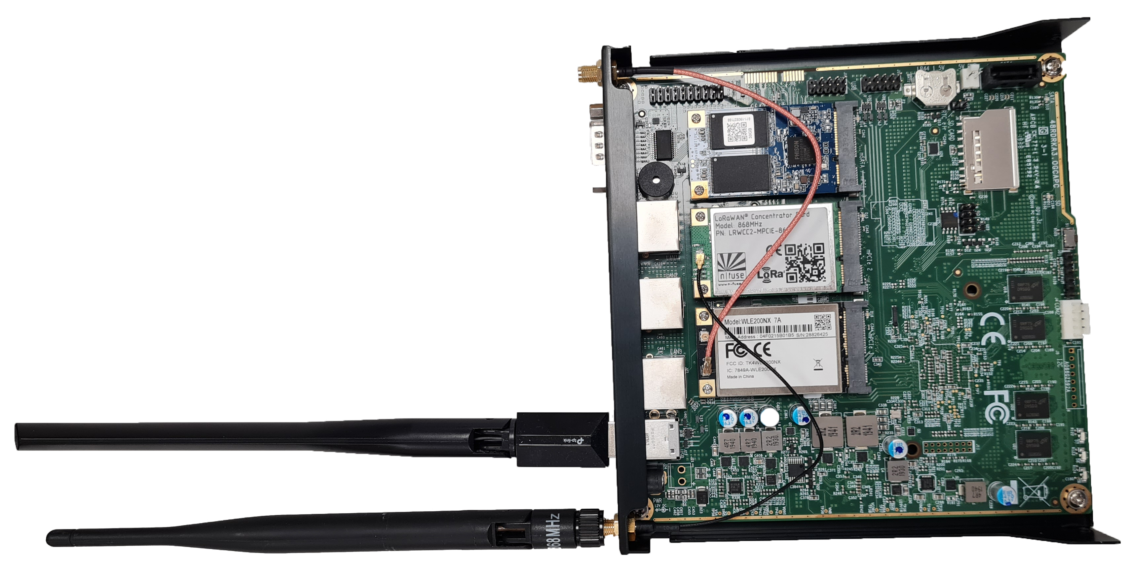
Solution Communication
- SSD
- LoRaWAN®
concentrator card
- Wi-Fi module
- WAVE antenna (868MHz)
- Wi-Fi antenna
17

Slide 18







Solution Data Persistence
API in Django
MySQL
InfluxDB
/missions
/drones
API | drone-backend
Celery
HTTP requests:
POST, GET, DELETE
Celery task
Celery task
...
/missions
/drones
Internet
GET /mission
GET /drone
API | fleet-manager
18
Groundstation

Slide 19

Solution Data Persistence
InfluxDB
MySQL
Drones
droneId
missionId
…
…
…
…
…
…
Missions
missionId
status
cause
start
end
duration
drones […]
MissionDrones
droneId
missionId
active
Fields
and
Tags
19

Slide 20
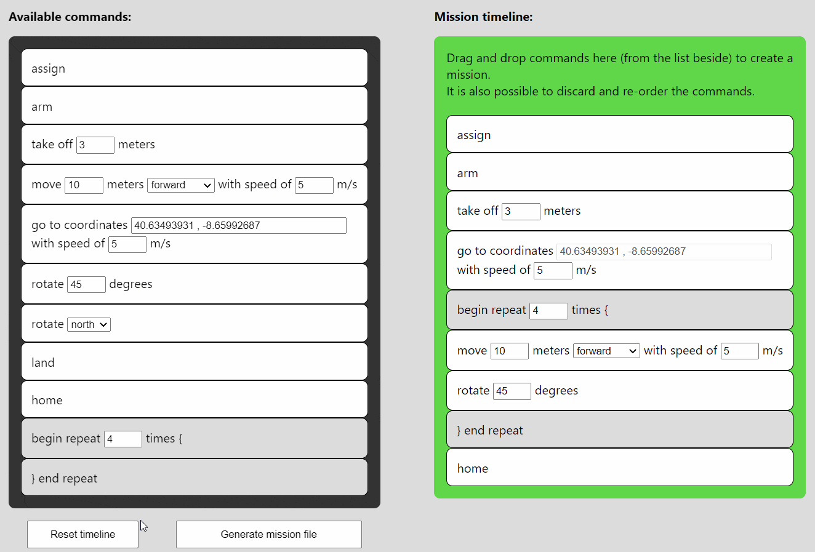



Solution Dashboard
Mission generator
20
Notes:
Um dos pontos fracos era

Slide 21
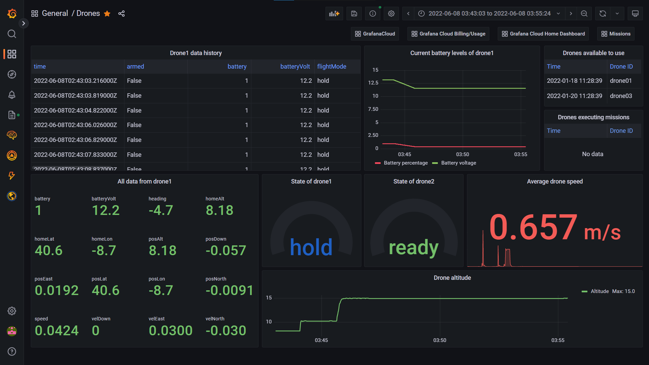

Solution Dashboard
Drones dashboard
21
Notes:
Plataforma open source

Slide 22
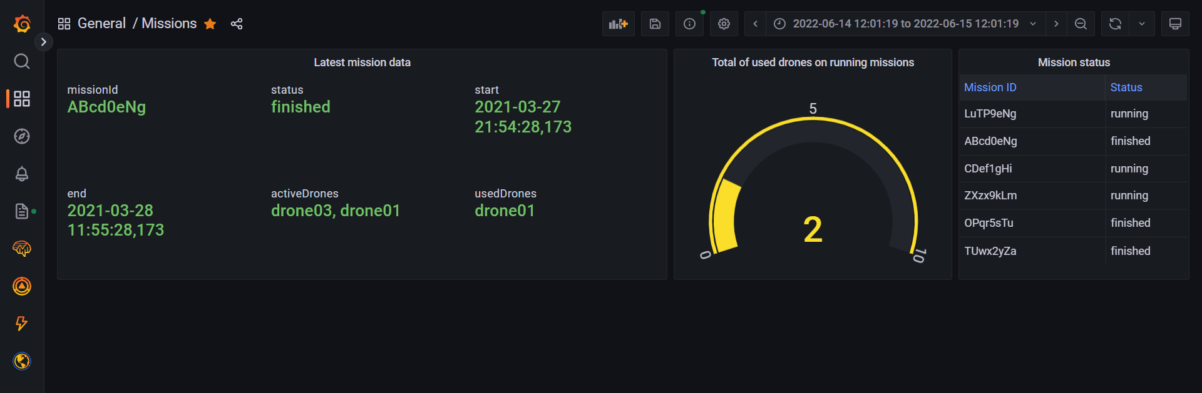
Solution Dashboard
Missions dashboard
22

Slide 23









Outcome
fleet-manager
Drones
API
Groundstation
3
4
WAVE
802.11p
2
6
5
Internet
1
7
User friendly
Mission Generator
Databases
8
API
12
11
9
10
Dashboard
23
drone-backend

Slide 24
Index
1. Context
1.1 Problem
1.2 Objectives
1.3 Methodology
2. Solution
2.1 Communication
2.2 Data Persistence
2.3 Dashboard
2.4 Outcome
3. Vision for the future
24

Slide 25
Mission: Surveillance and monitoring of important people
The VIP would have a device constantly generating a mission with just a go-to command with the coordinates where he is.
This mission is sent to the drone automatically by the mission generation platform.
Can make use of the live-streaming module developed by the 2020/2021 PEI group.
An AI algorithm could be developed to detect the VIP's face and keep the drone's camera pointed at him at all times, regardless of the movements the drone made.
25
Notes:
Fazer callback ao projeto anterior
Incentivar talvez a uma próxima iteração deste projeto

Slide 26
Thank you for your attention!
Questions?
26

